Slide 1
Project 3: Soccer Transfer Fee Analysis
Phase 1 & 2
Team Lorenzo：Yang Lu, Xinyu (April) Liang, Yinghan Liu, Mi Zhong, Jie Chen,
Cheng Zhang, Cheng Chen, Hangyu Zhou
ALLPPT.com _ Free PowerPoint Templates, Diagrams and Charts

Slide 2
Business Goal
Predict the future transfer fee!
Figure out the pattern in club-to-club and league-to-league transfer
Build models to evaluate reasonable transfer fee based on club, league, transfer period and player’s profile
Provide predicted transfer price for clubs

Slide 3
Data Collection
Data Resources
http://www.transfermarkt.com (Actual transfer fee that happens, players has been transferred, leagues’ market value, clubs’ market value etc.,)
http://www.pesmaster.com/pes-2017/search/?myclub=yes (Profile of players)
http://pesdb.net/pes2017/ (backup Resource)
4 tables: Player’s Profile, Clubs’ table, Leagues’ table, Transfer table

Slide 4
Variable
Dependent Variable：
Transfer Fee
Independent Variable：
Player, Position, Position Summary, Transfer From(Club), Transfer From(League), Club Rate, League Rate, Transfer to(Club), Transfer to(League), Transfer Period
Age, Height, Overall rating, Pass, Shot, Physical Contact, Defensive Prowess, Speed, Dribbling, Current Market Value, Club Market Value(Mill), League Market Value

Slide 5
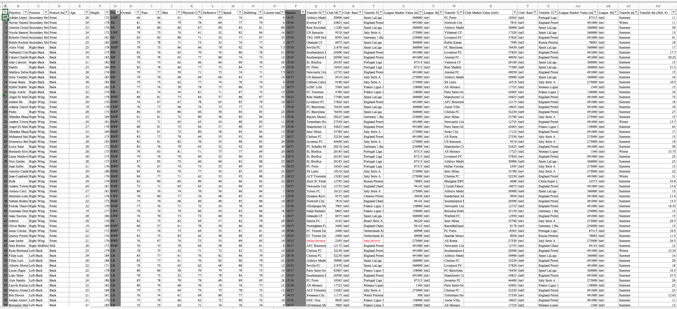
Dataset

Slide 6
Descriptive Statistic
Dependent Variable (Million)
Mean | 21.274354
Std Dev | 13.956945
Std Err Mean | 0.8139856
Upper 95% Mean | 22.876353
Lower 95% Mean | 19.672354
N | 294

Slide 7
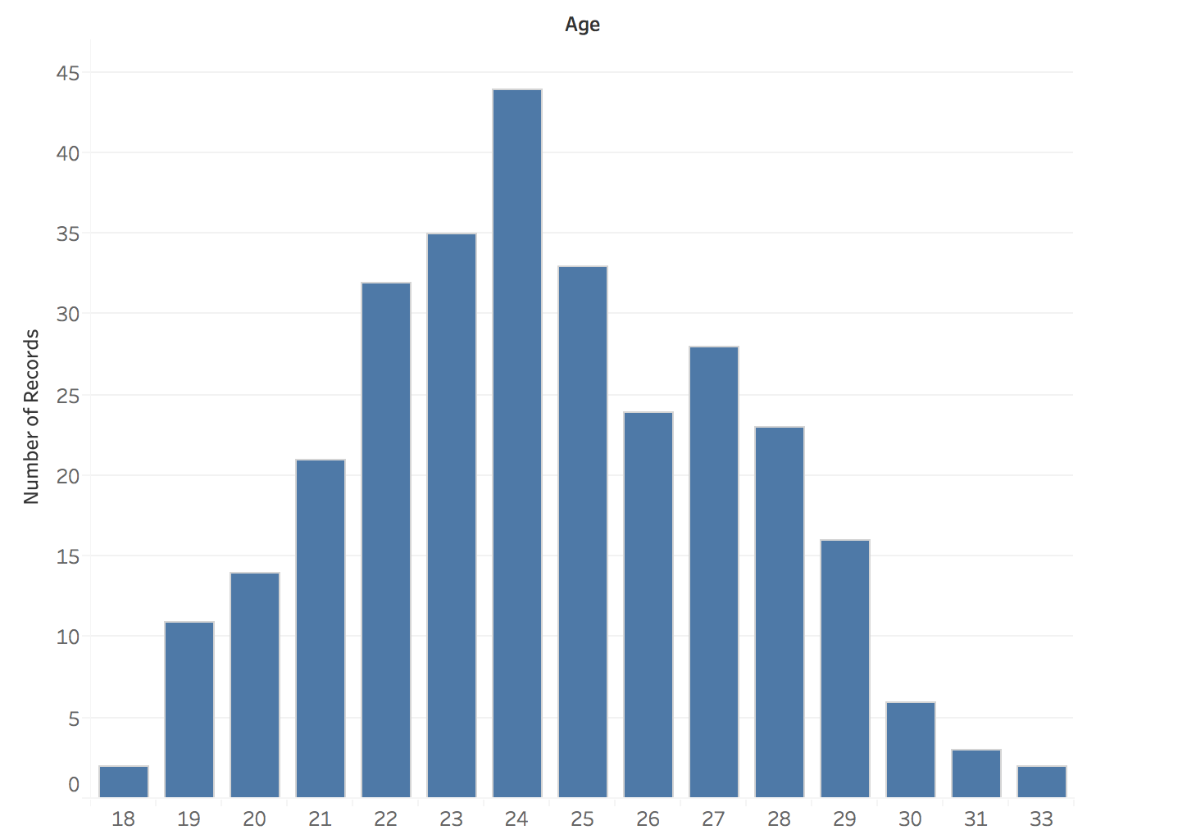
Age Distribution

Slide 8
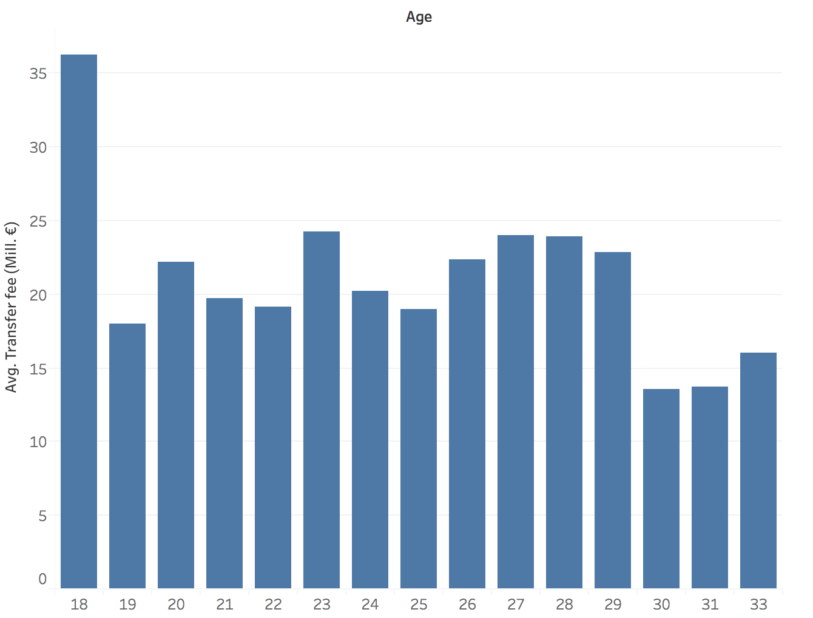
Average Transfer Fee by Age

Slide 9
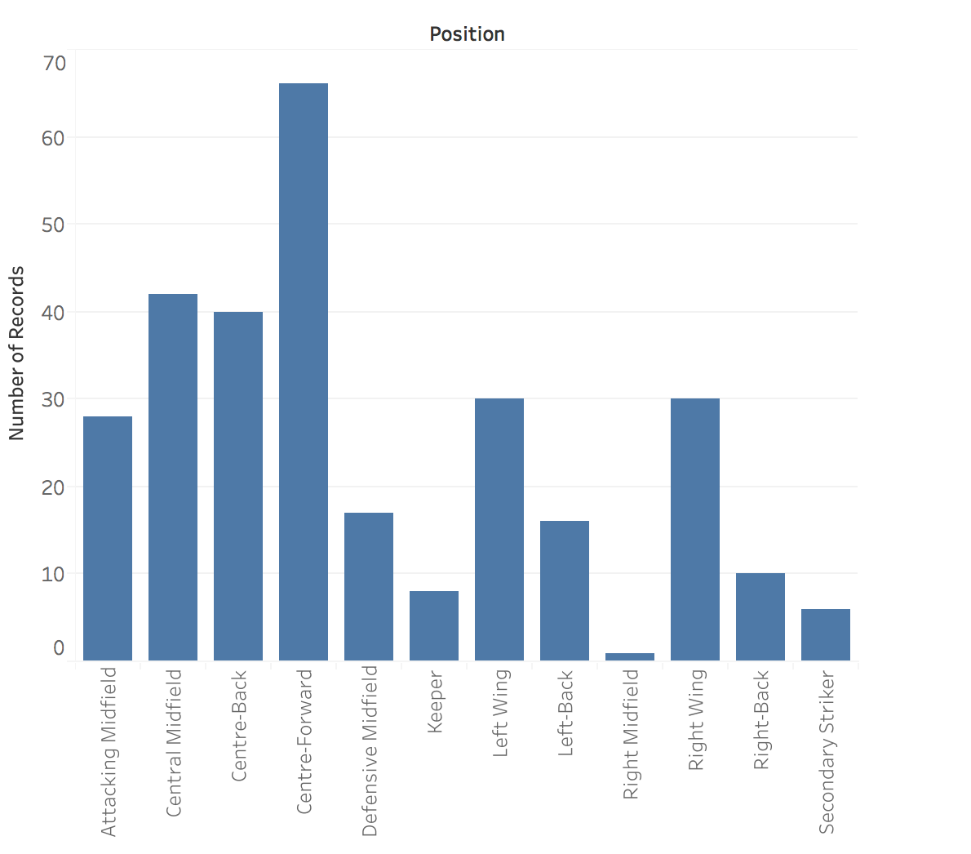
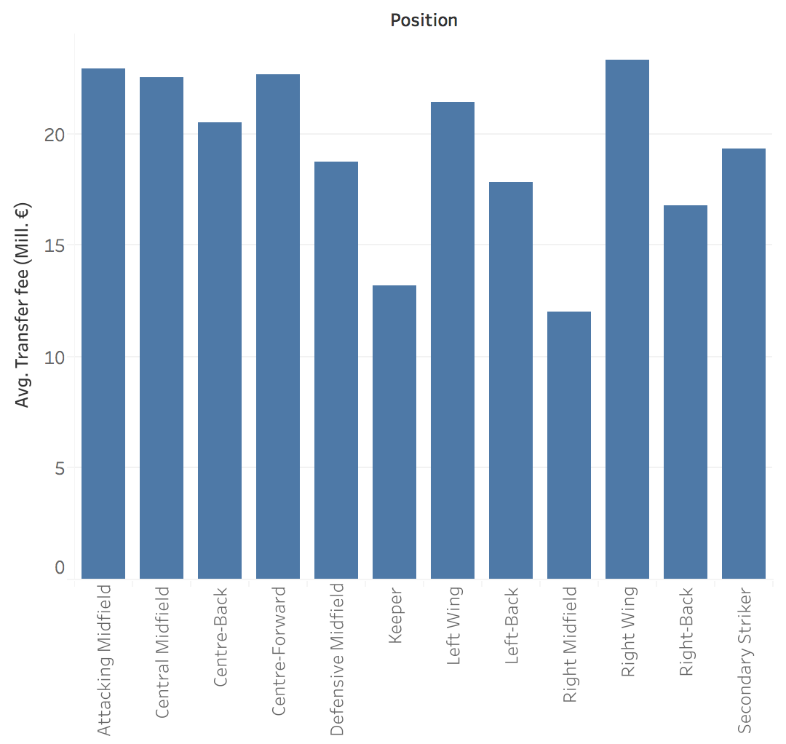
Average Transfer Fee by Position

Slide 10
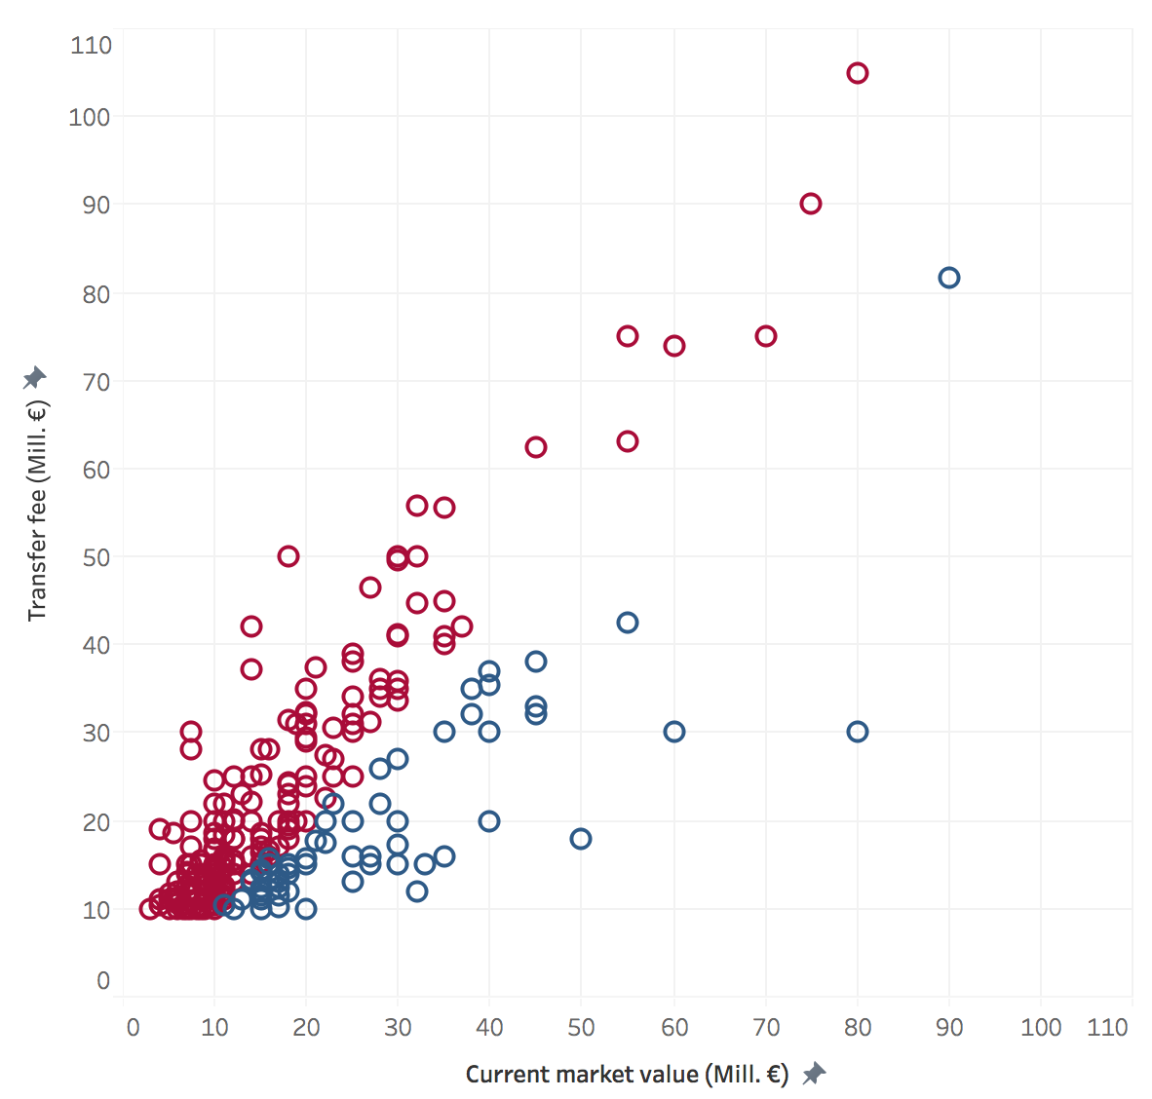
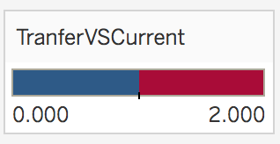
Actual Transfer fee vs. Current Players’ Market Value

Slide 11
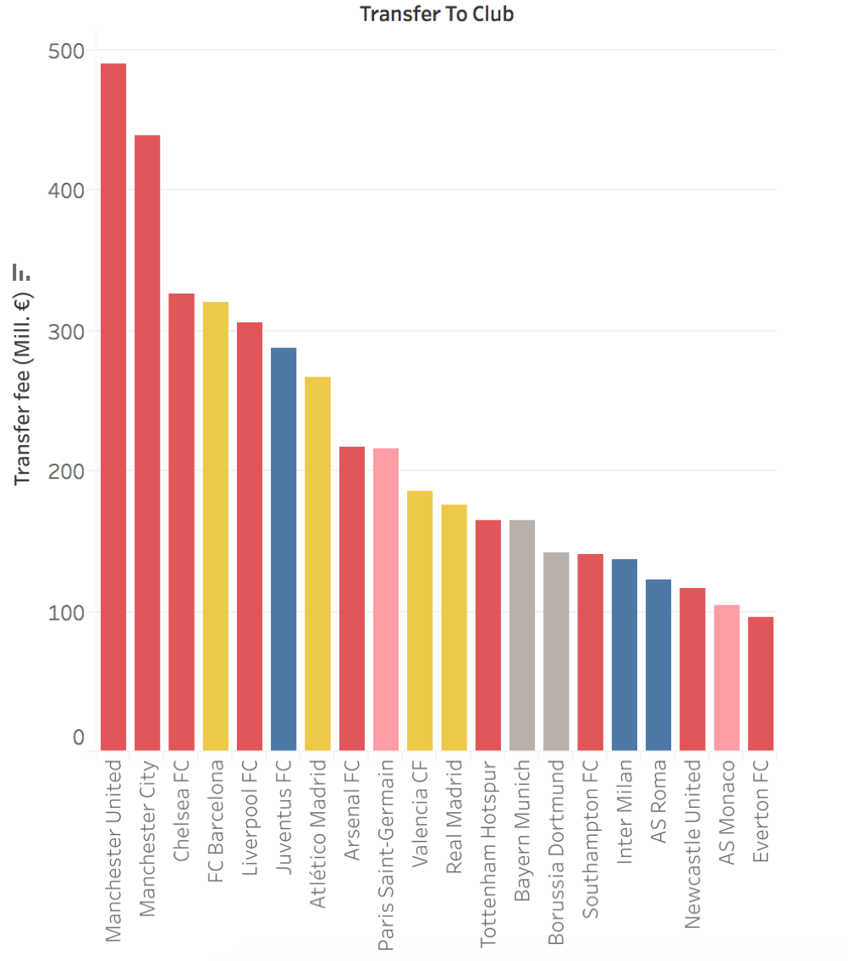
Top 20 Club

Slide 12
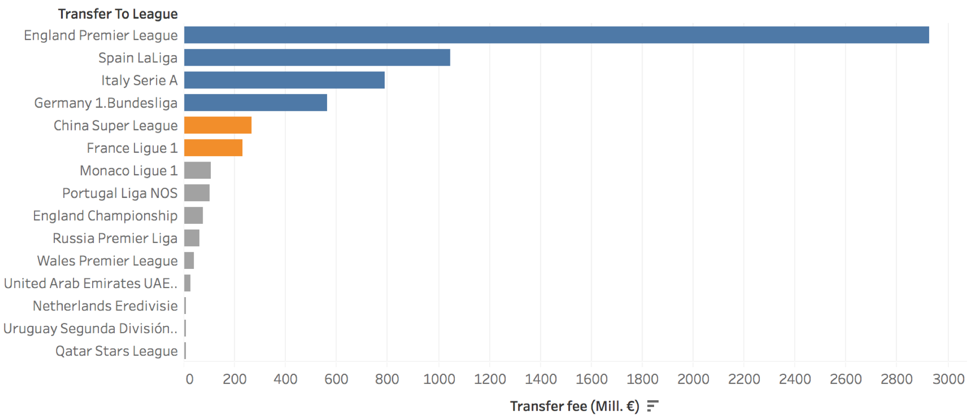
League Activity

Slide 13
